Slide 1
Documenting Architecture Views
Harvinder S Jabbal
SSZG653 Software Architectures

Slide 2
SEZG651/ SSZG653
Software Architectures
Module 4-CS 06A

Slide 3
Architecture Views

Slide 4
Views
Representation of a coherent set of architectural elements , as written by and read by system stakeholders.

Slide 5
Documenting
“Documenting an architecture is a matter of documenting the relevant views and then adding a documentation that applies to more than one view.”

Slide 6
Solution to a Problem
Problem
Architecture documents do not address the concerns of all stakeholders .
Deferent Stakeholders : end-user, system engineers, developers and project managers.
Architecture documents contained complex diagrams some times they are hard to be represented on the documentation.
Solution
Using different notations for several Views each one addressing one specific set for concerns.

Slide 7
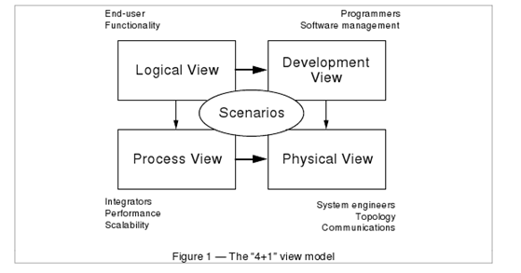
4+1 Model -
Philippe Kruchten, Rational Software Corp.

Slide 8
Logical View
• The logical view, which is the object model of the design (when an object-oriented design method is used)
Viewer: End-user
considers: Functional requirements- What are the services must be provided by the system to the users.
Notation: The Booch notation .
Tool: Rational Rose

Slide 9
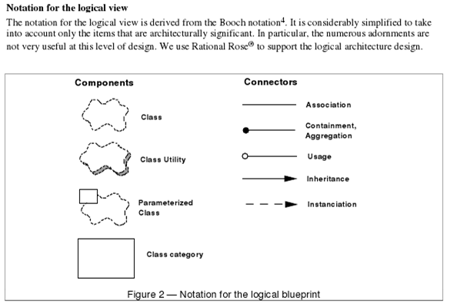
Notation for Logical View-
Philippe Kruchten, Rational Software Corp.

Slide 10
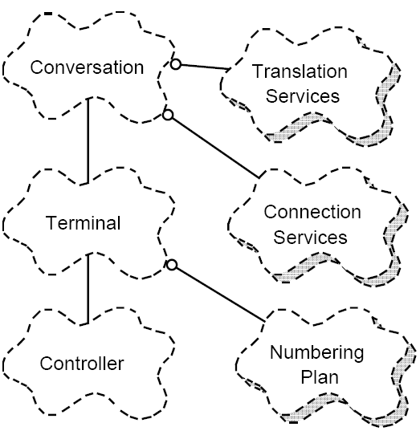
Logical view Example PABX-
Philippe Kruchten, Rational Software Corp.

Slide 11
Process View
The process view, which captures the concurrency and synchronization aspects of the design(The process decomposition).
viewer: Integrators
considers: Non - functional requirements (scalability, concurrency, and performance)
style: Garlan and Shaw ‘s Architecture styles.

Slide 12
Process (cont.)
Uses multiple levels of abstractions.
A process is a grouping of tasks that form an executable unit:
Major Tasks: Architecture relevant tasks.
Minor or helper Tasks: (Buffering)

Slide 13
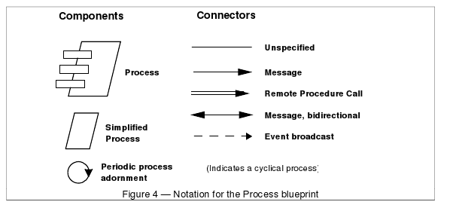
Notation-
Philippe Kruchten, Rational Software Corp.

Slide 14
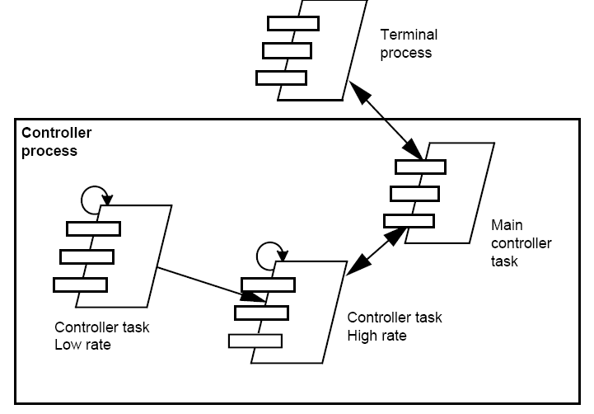
Process View example PABX (partial)-
Philippe Kruchten, Rational Software Corp.

Slide 15
Development View
The development view, which describes the static organization of the software in its development environment.
Viewer: Programmers and Software Managers
considers: software module organization. (Hierarchy of layers, software management, reuse, constraints of tools).
Notation: the Booch notation.
Style: layered style

Slide 16
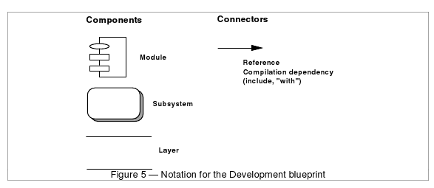
Notation for Development blueprint-
Philippe Kruchten, Rational Software Corp.

Slide 17
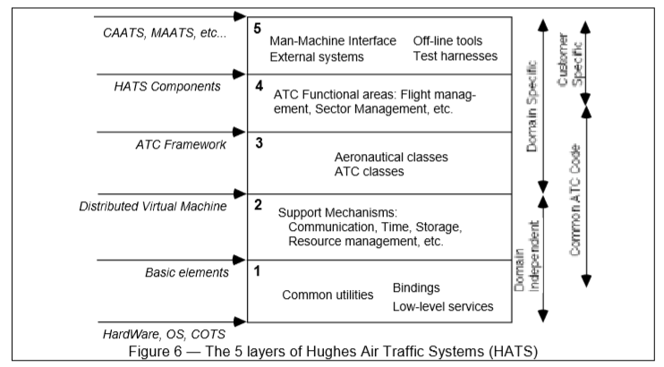
Development View – Layered Style
Philippe Kruchten, Rational Software Corp.

Slide 18
Physical View
the physical view, which describes the mapping(s) of the software onto the hardware and reflects its distributed aspect.
Viewer: System Engineers
Considers: Non-functional requirement (reliability, availability and performance). regarding to underlying hardware.
There may be two architecture:
Test and development
deployment

Slide 19
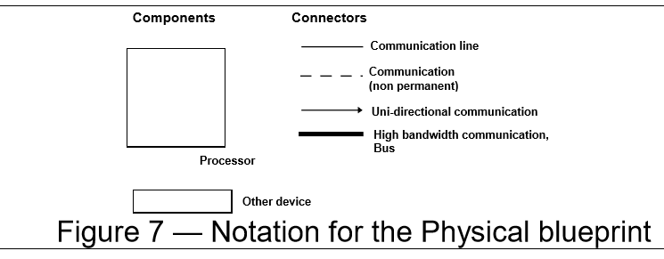
Notation for Physical view-
Philippe Kruchten, Rational Software Corp.

Slide 20
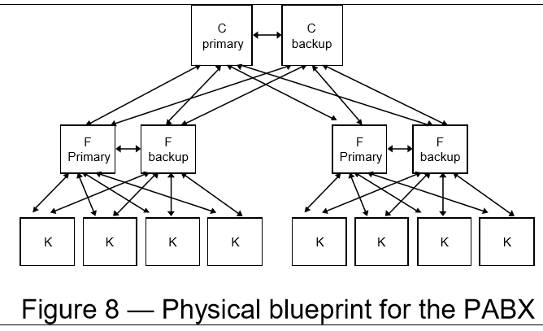
Physical blueprint PABX-
Philippe Kruchten, Rational Software Corp.

Slide 21
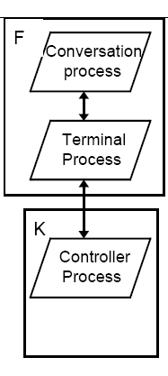
Physical view example-
Philippe Kruchten, Rational Software Corp.
A small PABX physical architecture with process allocation.

Slide 22
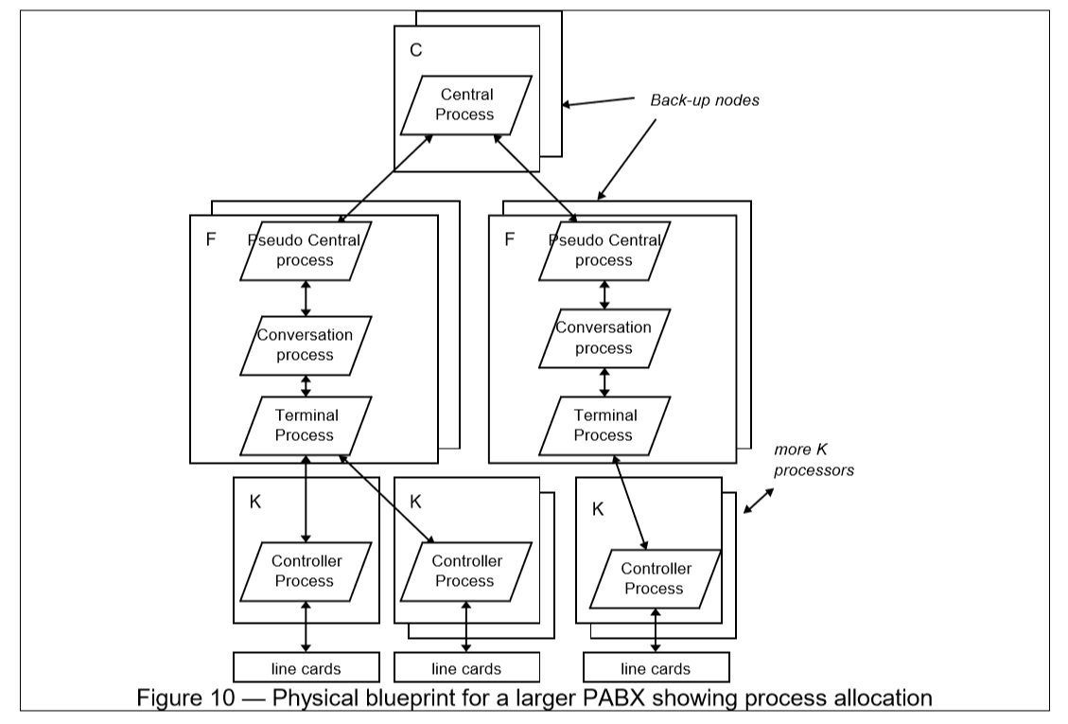
Physical view example-
Philippe Kruchten, Rational Software Corp.

Slide 23
Scenarios
(Putting all “4 views” together)
Viewer: All users and Evaluators.
Considers: System consistency and validity
Notation: Similar to logical view

Slide 24
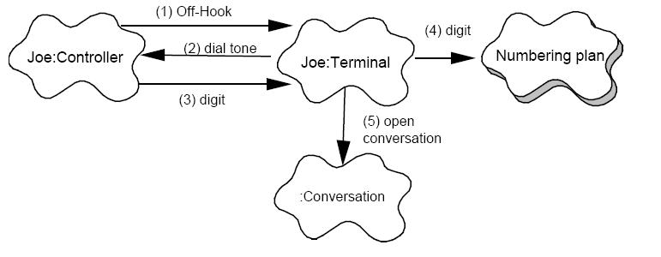
Scenario example-
Philippe Kruchten, Rational Software Corp.
Scenario for a Local call – selection phase

Slide 25
Correspondence between the views
The views are interconnected.
Start with Logical view and Move to Development / Process view and then finally go to Physical view.

Slide 26
From logical to Process view
Two strategies :
Inside-out: starting from Logical structure
Outside-in: starting from physical structure

Slide 27
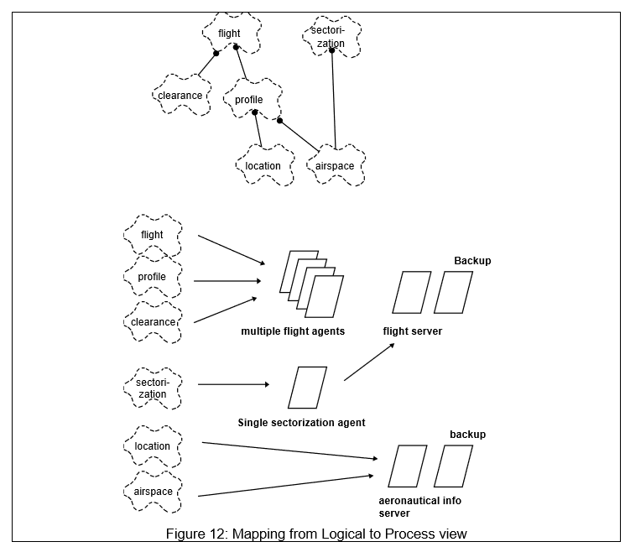
From logical to Process view

Slide 28
From Logical to development
They are very close, but the larger the project, the greater the distance between these views.
Grouping to subsystems depending on:
The team organization.
The class categories which includes the packages.
The Line of codes.

Slide 29
Iterative process
Not all architectures need all views.
A scenario-driven approach to develop the system is used to handle the iterative.
Documenting the architecture:
Software architecture document: follows closely “4+1” views.
Software design guidelines: it captured the most important design decisions that must be respected to maintain the architectural integrity.

Slide 30
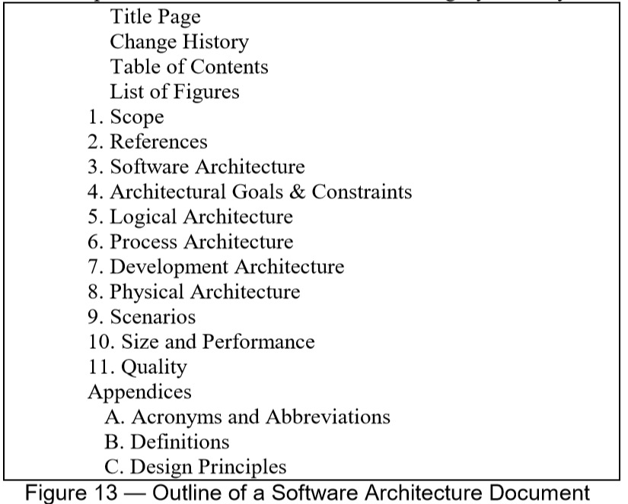
Software Design Document

Slide 31
Annotation:
“4+1 views” methodology successfully used in the industry
Air Traffic Control
Telecom
This paper missing the tools to integrate these views which lead to an inconsistency problem.
The inconsistency problem is more tangible in the maintenance of the architecture.

Slide 32
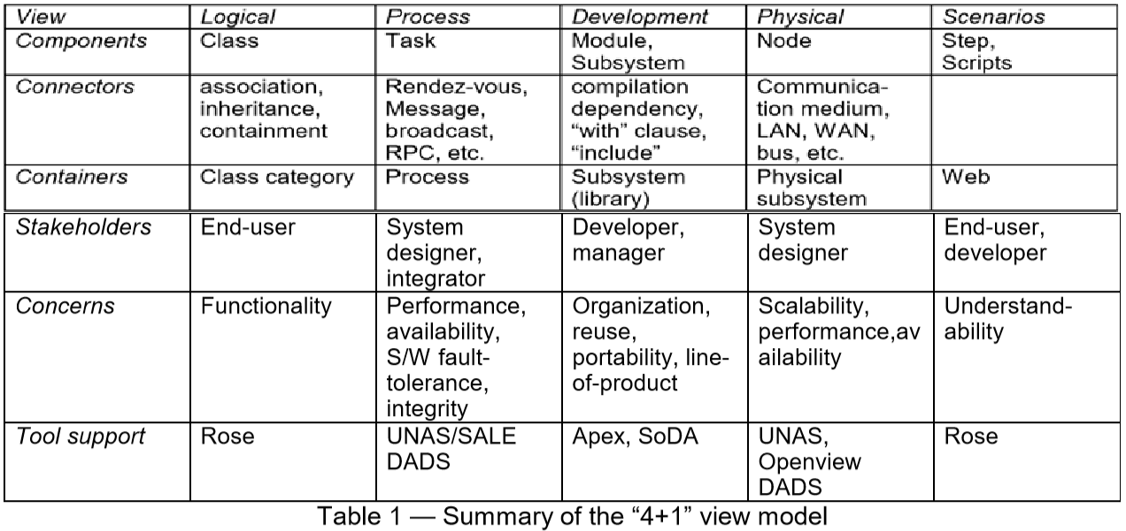
Summary

